Slide 1

iClicker - First Day of Class Slides
Note to Instructors:
This presentation deck outlines the steps your students should take to prepare for class if you will be integrating iClicker Cloud with your Learning Management System using Roster & Grade Sync.
Text marked in RED should be changed to better suit your course/campus setup.

Slide 2
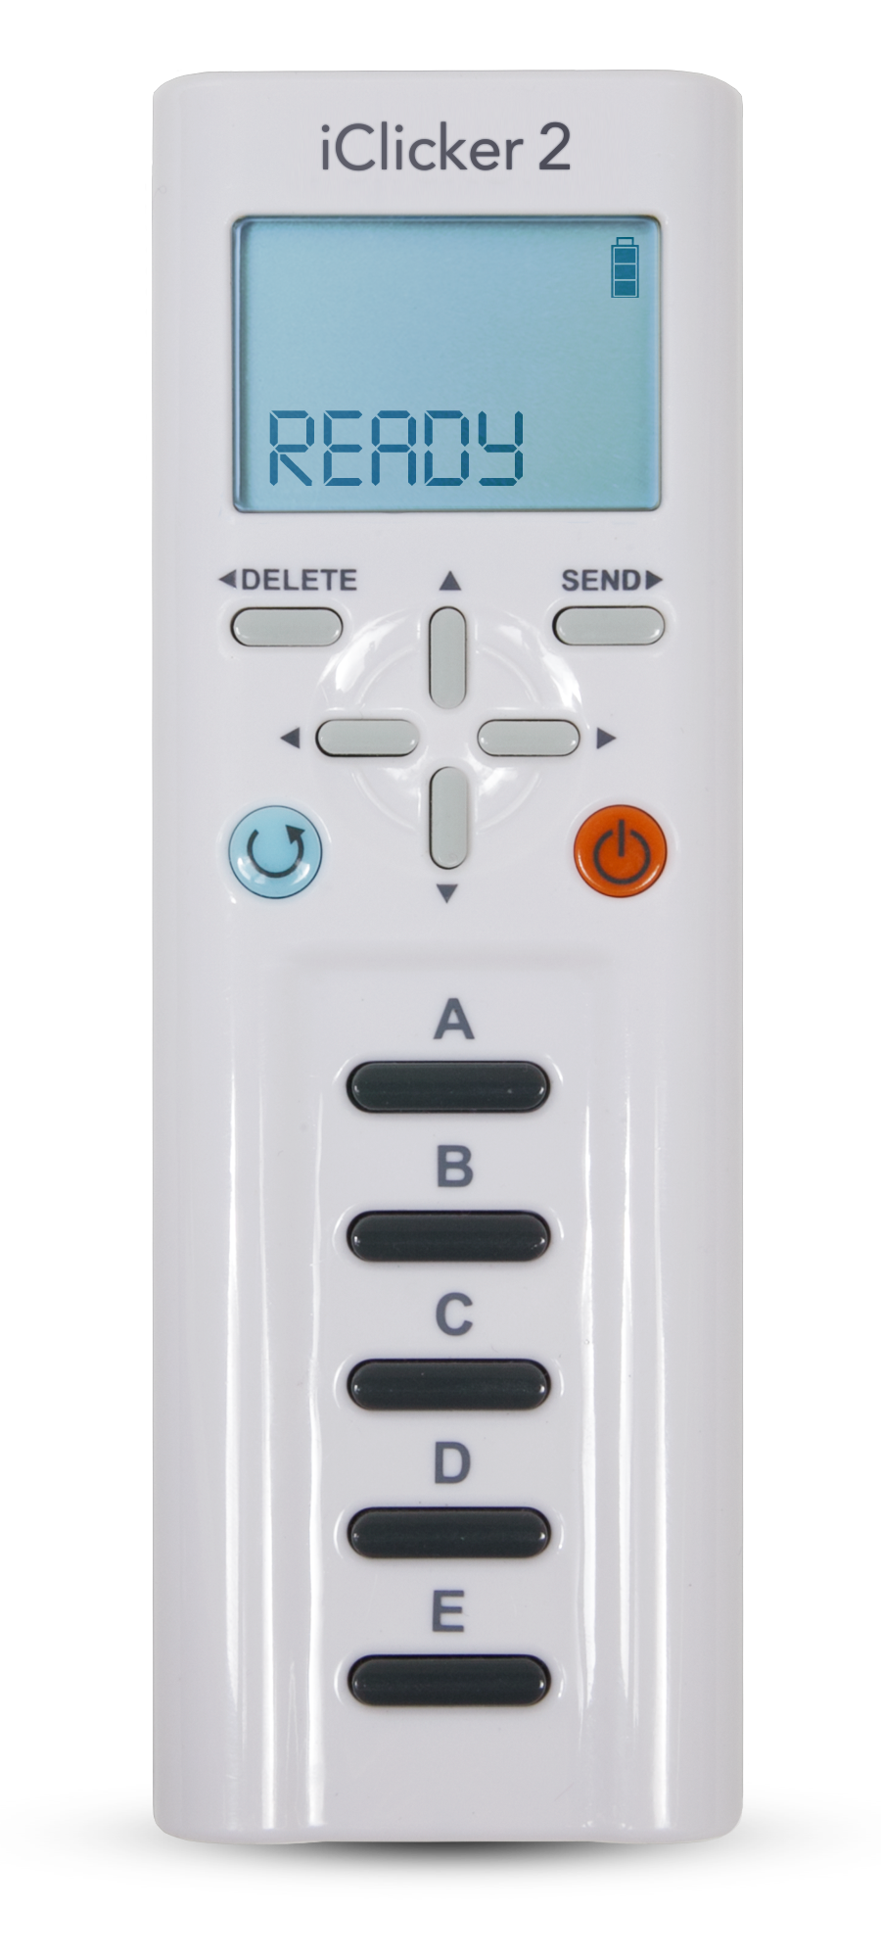
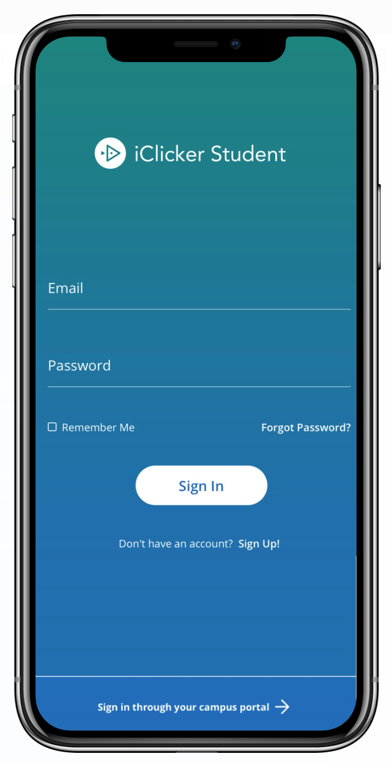
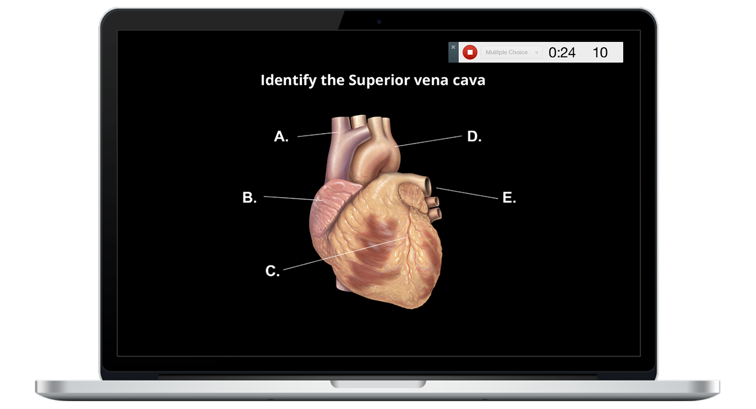
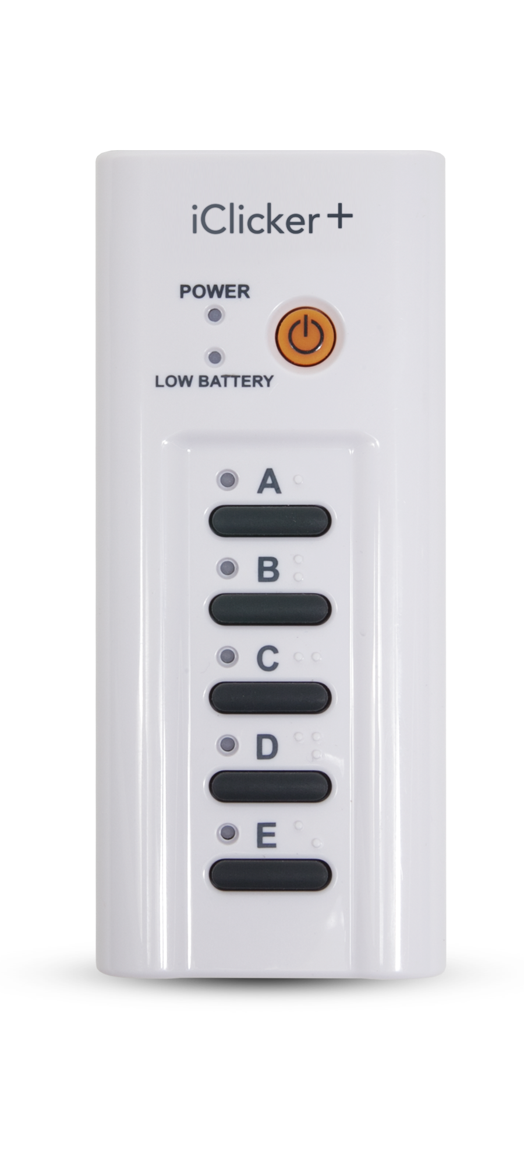
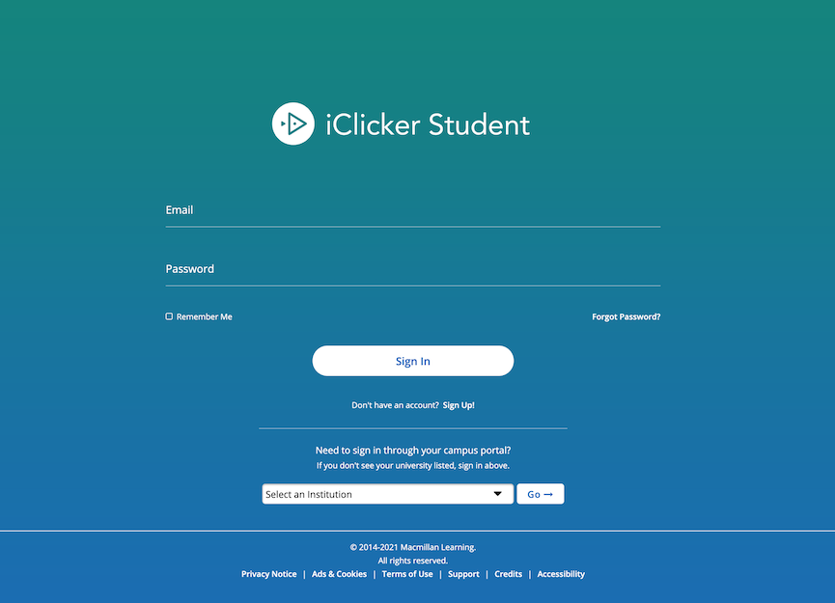
Devices allowed in class
[Delete any device images that are not relevant to your course.]
You are required to bring a device to participate in my class sessions.
I will be allowing the use of the iClicker student app (on a smartphone, tablet or laptop), iClicker remotes, or both. Please note: No matter what you choose to use you MUST create an iClicker student account. If you are using a remote you will not purchase a subscription but you need an iClicker student account to sync to Brightspace. Directions on registering the remote in your iClicker student app profile will be shown in this slide deck.

Slide 3

Check your email!
I have set up an iClicker integration with our Brightspace course, which pulls your names directly into my iClicker roster.
If you have an existing iClicker account that uses your preferred email address and/or V Number, you will automatically be added to our iClicker course. Check your courses list in the iClicker app to make sure!
If the iClicker system does not find a matching iClicker student account, you will receive an email from iClicker Support with instructions to update your existing account's profile or create a new account.
Please note: This email may appear in your Spam or Junk folders.

Slide 4
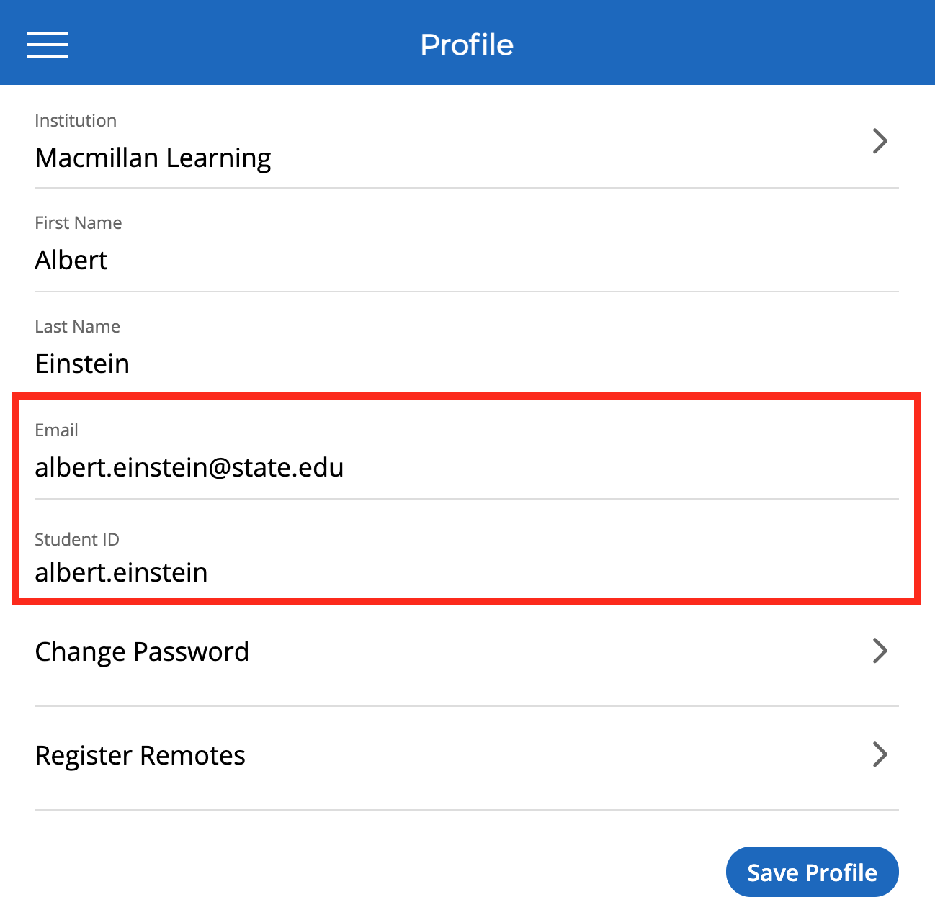
Editing an existing iClicker account
If you already have an iClicker account:
You may need to edit your existing iClicker account so you are using your preferred email address (as listed in the Online Tools area of your UVic My Page) and Student ID (V Number)
Visit iClicker.com > Sign In > Student
Select Menu > Profile and make your edits
Click Save Profile before exiting if you are using the iClicker web app.

Slide 5
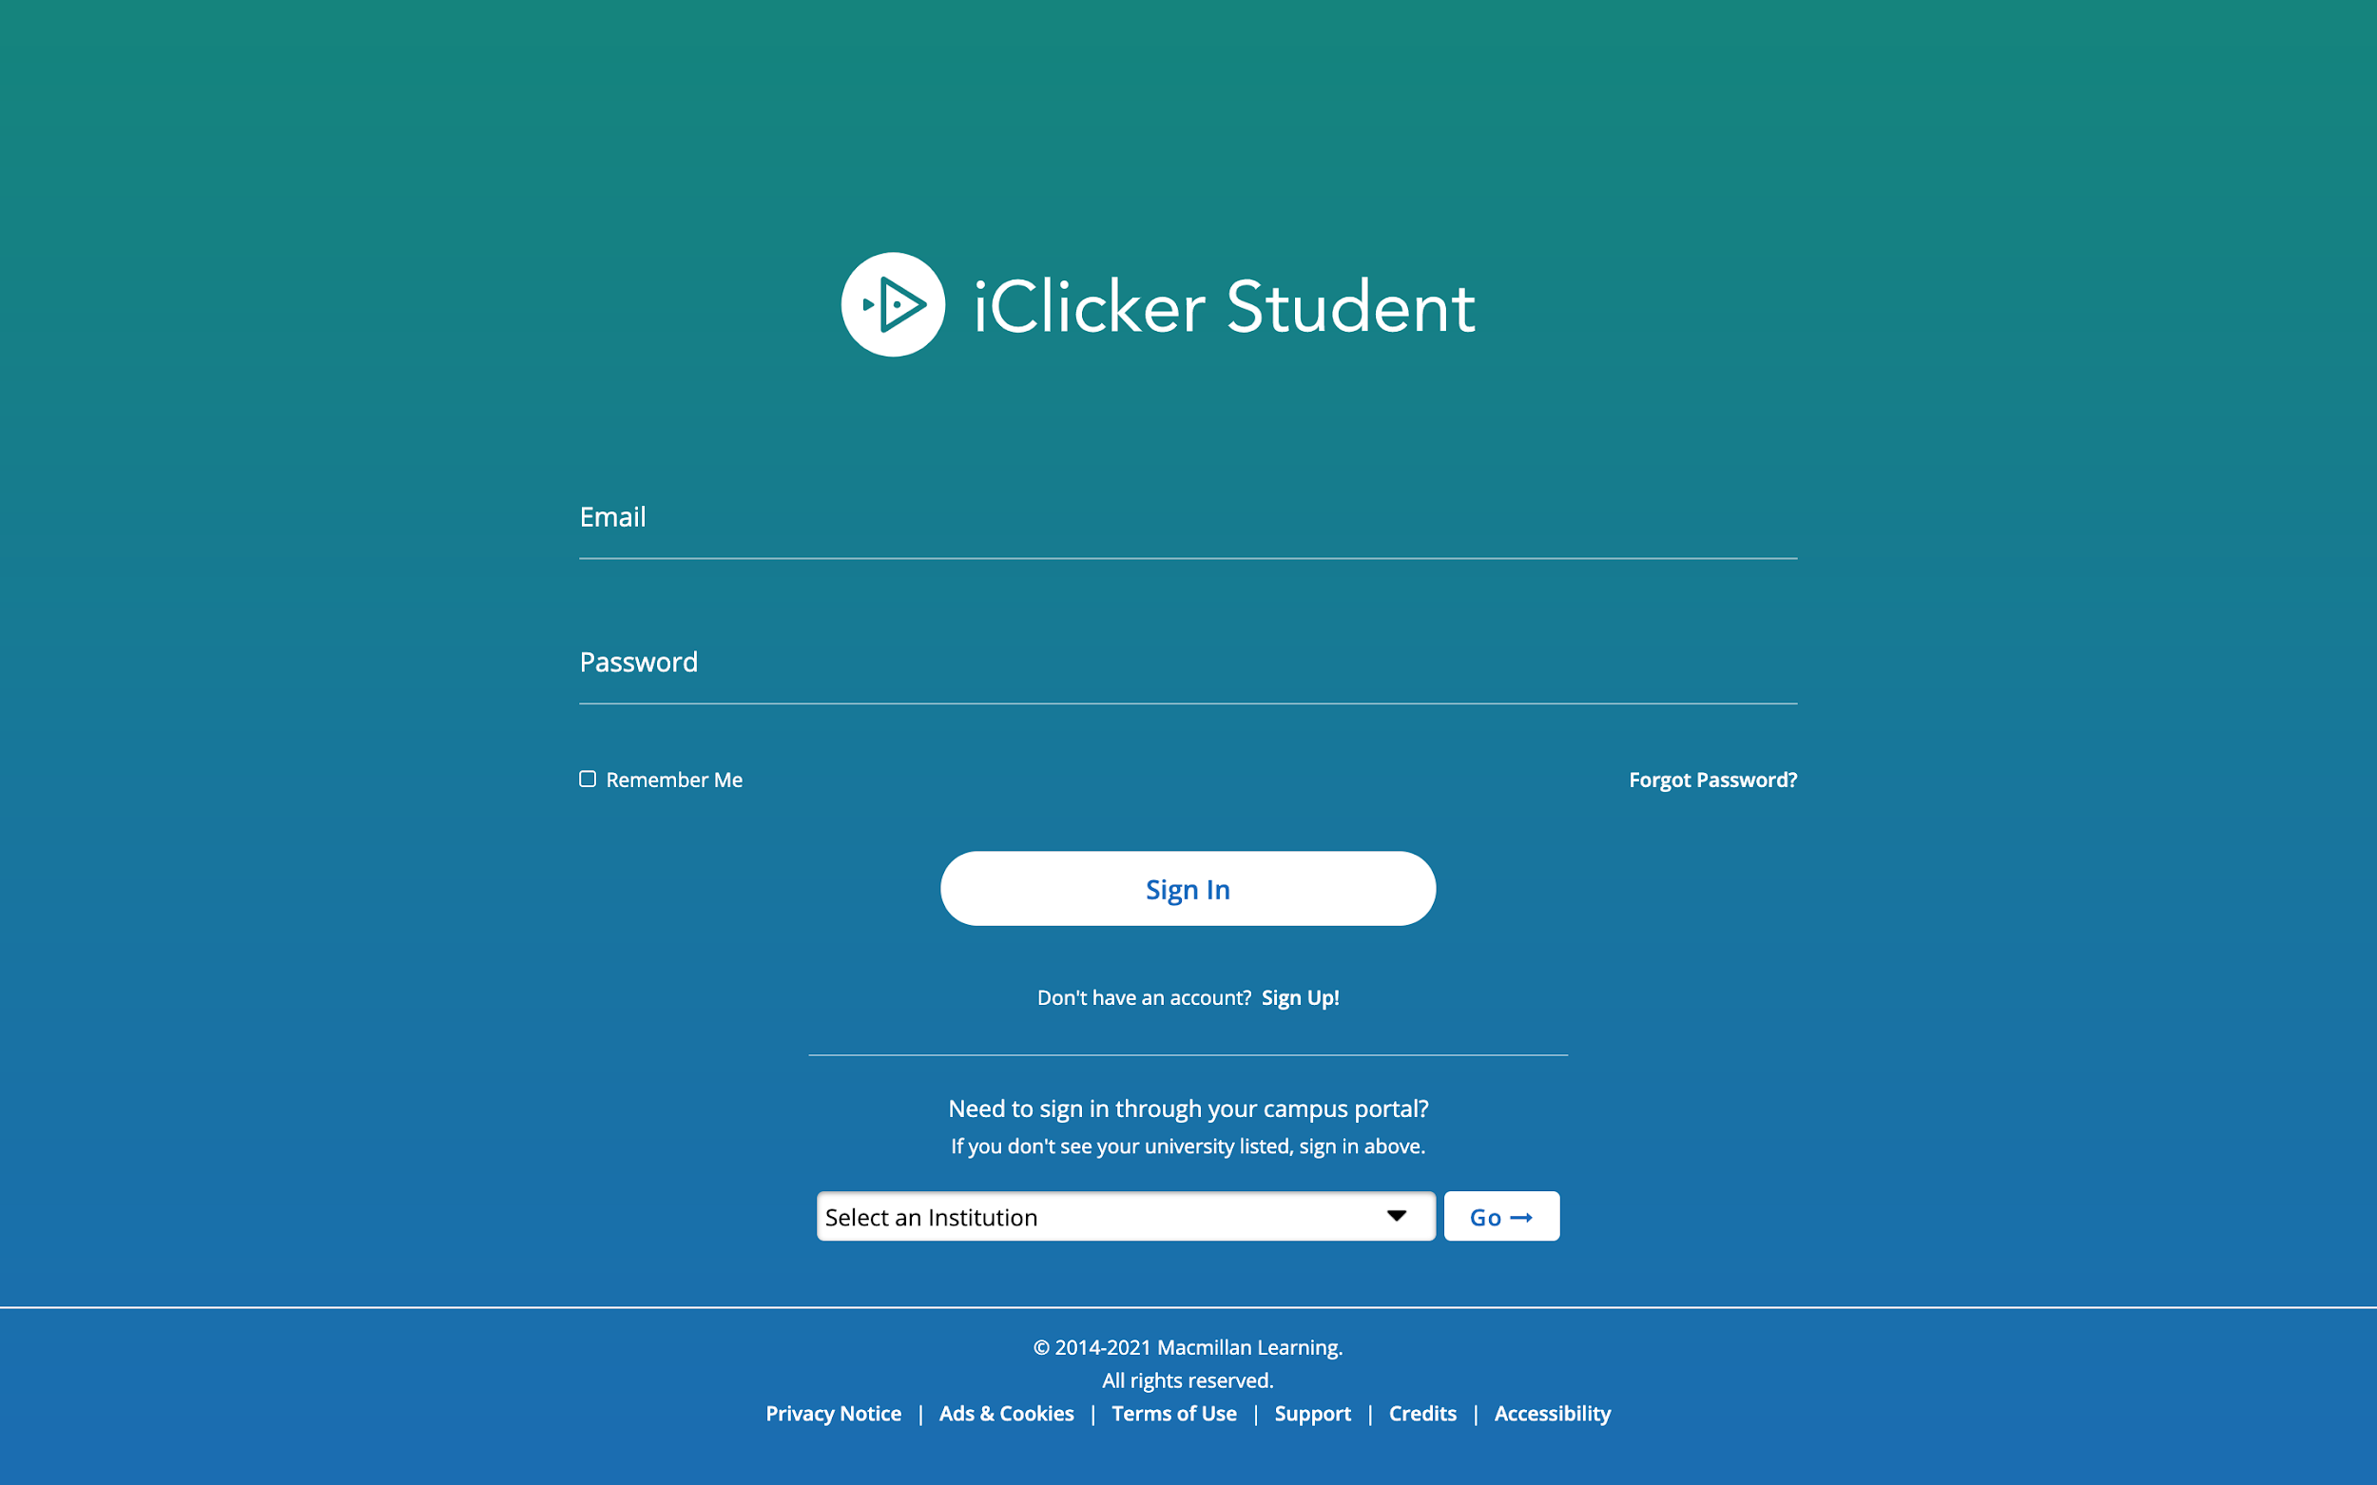
Creating a new iClicker account
You must create an iClicker account to ensure your grades are counted:
Visit iClicker.com > Create an Account > Student.
Or, download the iClicker Student iOS/Android app. Select Sign Up! to create your account.
If you already have an iClicker account, just sign in! Do not create and use more than one iClicker account as you will only receive credit from a single account.

Slide 6
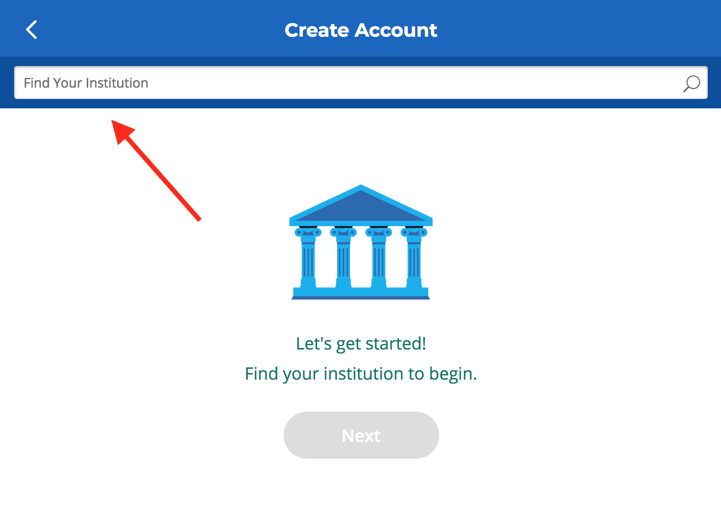
Enter your institution
Enter University of Victoria as your institution when creating your account.
Select Next.

Slide 7
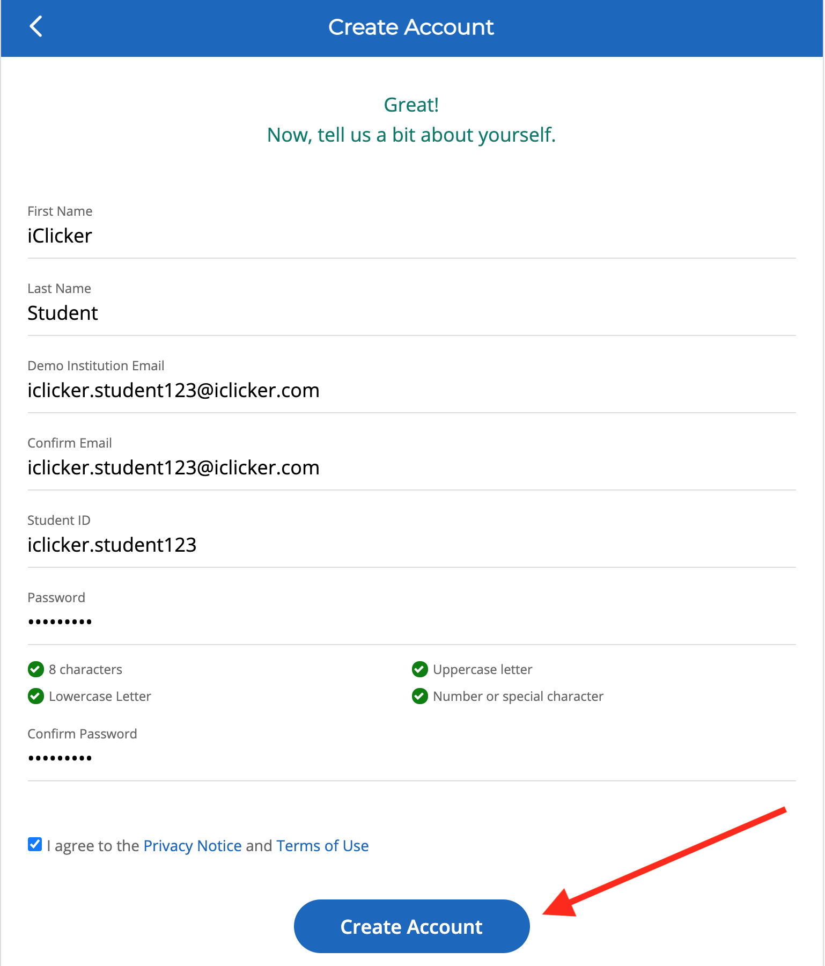
Complete your iClicker profile
On the Create Account form, fill out your:
First Name
Last Name
Preferred Email (as listed in your Uvic My Page)
Student ID (V number)
Create and confirm your password.
Select Create Account.

Slide 8
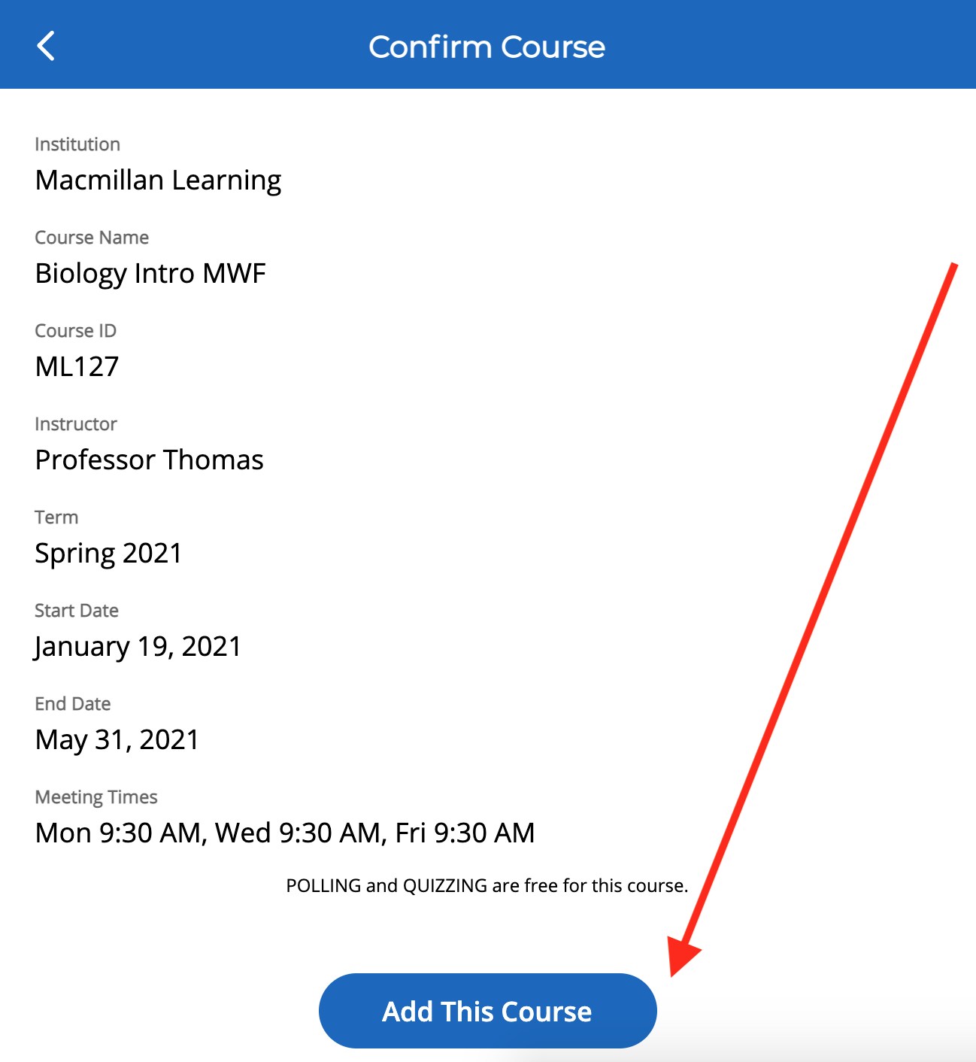
Check your iClicker course list
Sign in to the iClicker student mobile or web app. You should be dropped directly into this course, Course Name from iClicker Cloud.
If you don’t see this course in your account, use the + sign to search for my course:
Enter Institution Name from iClicker Cloud as your institution.
Enter Course Name from iClicker Cloud as your course.
Select Add This Course and it will be added to the main screen of the iClicker app.

Slide 9
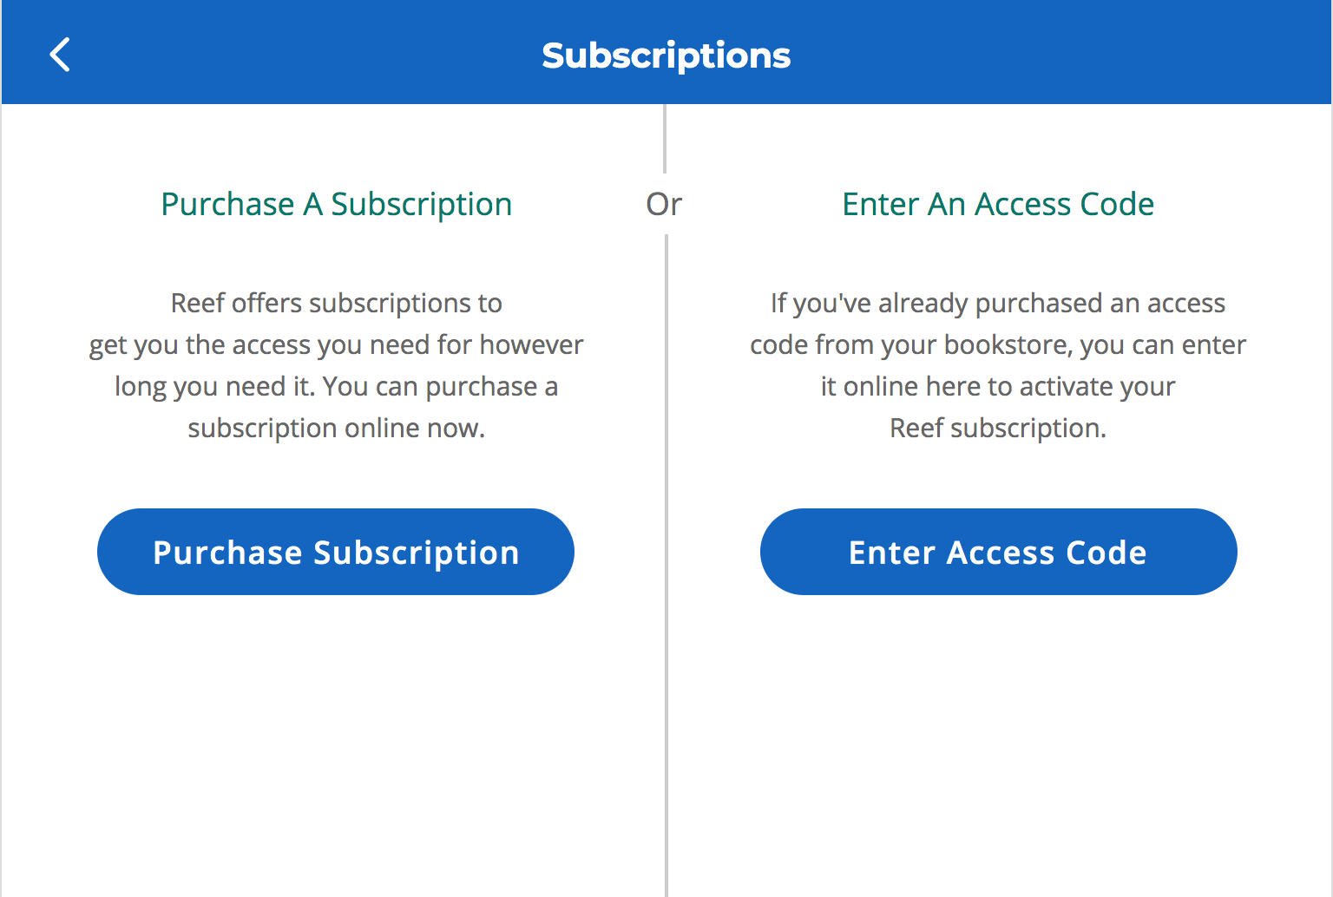
Paying for access to iClicker
[Delete this slide if your institution has a site license or if you are not allowing mobile devices in your classroom.]
When you create a new iClicker student account, you will have two-week free-trial period to participate in class sessions.
Before the trial period ends, you will need to purchase a subscription or redeem an access code in the Subscriptions section of your iClicker student account.
Access codes must be entered using iClicker through your web browser, not the mobile app.
Contact the campus bookstore with additional questions.

Slide 10
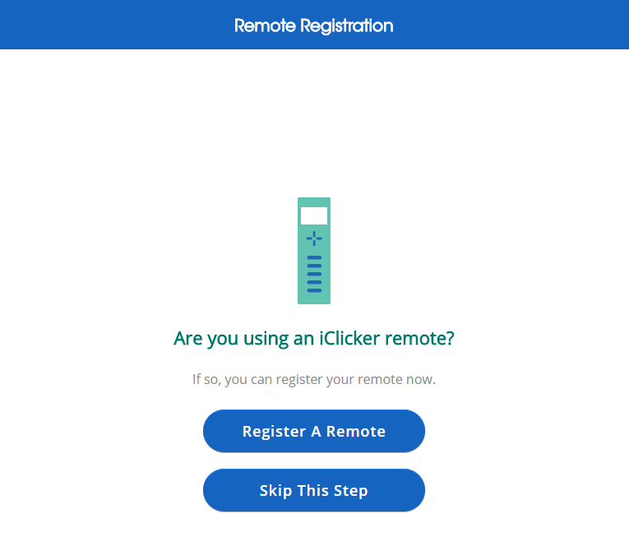
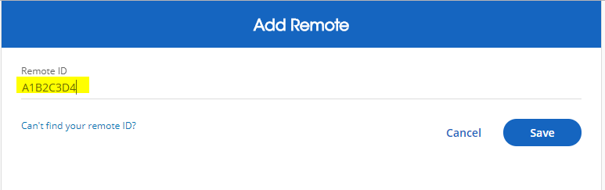
Add your iClicker remote ID
[Delete this slide if you are not allowing iClicker remotes in your classroom.]
If you are using a physical remote to participate in iClicker sessions, you DO NOT have to pay for an iClicker subscription and can ignore any “Buy” messages.
You must register your 8-digit iClicker remote ID (found on the back of your remote) in your iClicker account. The first time you sign in to iClicker, you will be prompted to Register A Remote.
You can also add or update your remote registration at any time through the Menu > Profile section of the app.

Slide 11
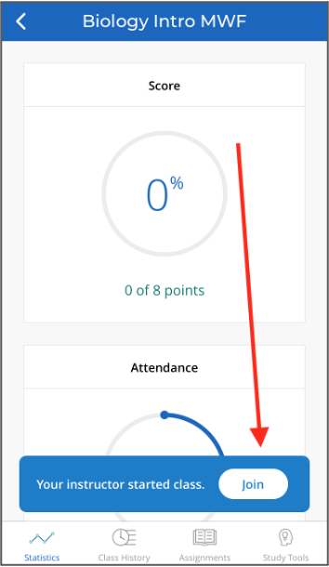
Now you’re ready to go!
[Customize based on the devices you’re allowing in your classroom.]
iClicker Remote Users: Make sure you are connected to my frequency: AA.
iClicker App Users: When I start a session, you will see a button appear on your screen to Join my class. Select this button to start participating in my session for the day.

Slide 12
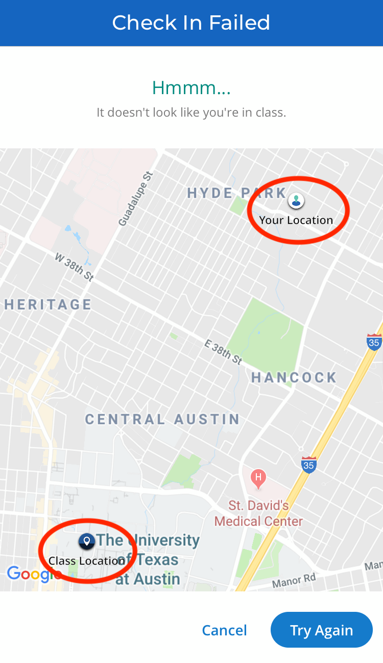
You must physically be in class to participate
[Delete this slide if you are not enabling the GPS location requirement for Attendance.]
I have enabled a GPS location requirement for this class, so if you are not physically present, you will not be able to check in and will be marked as absent.
Check out iClicker’s Geolocation Attendance Tips for more info.

Slide 13
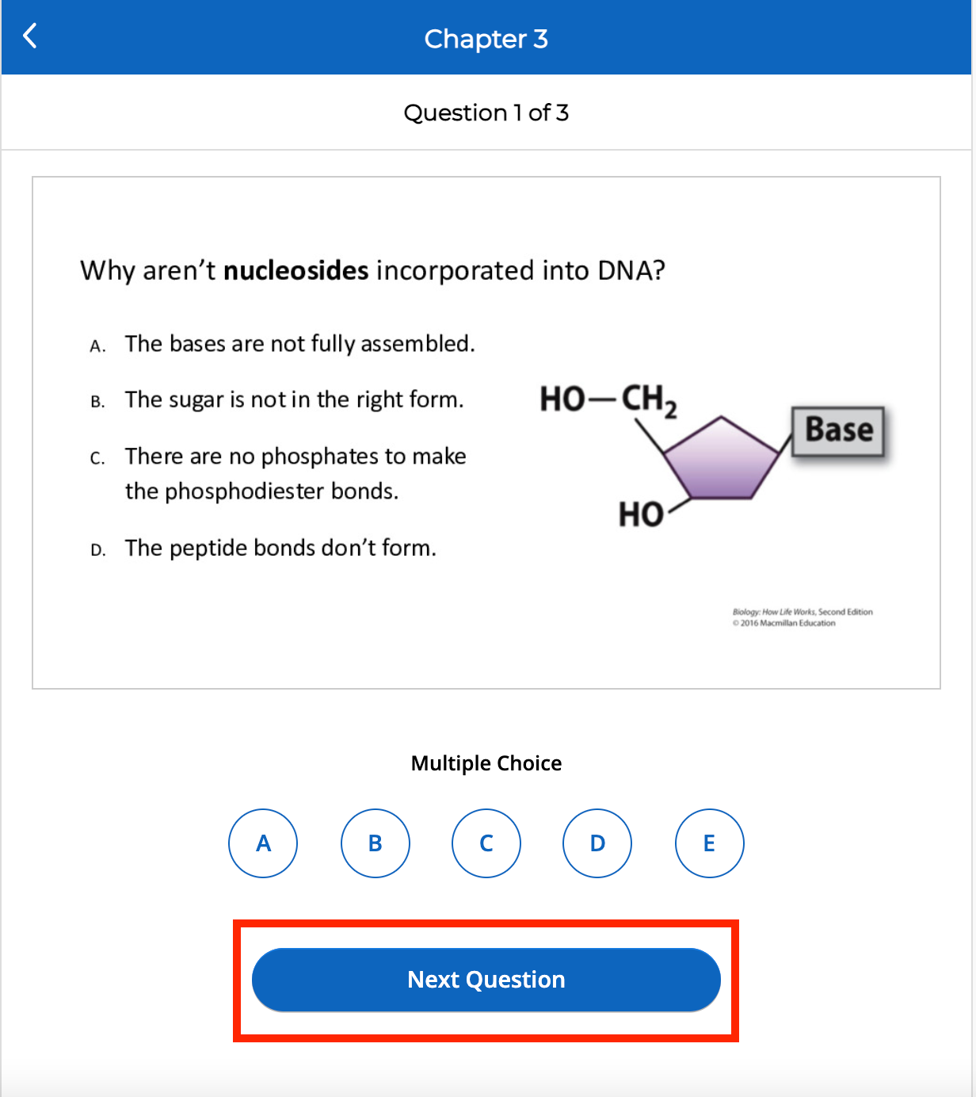
Complete an assignment
[Delete this slide if you are not using the Assignments feature.]
In the Assignments section of iClicker, you’ll find multi-question activities that you can complete at your own pace.
You can exit and return, and change your answers, as many times as you’d like up until the due date or until you submit the assignment.

Slide 14
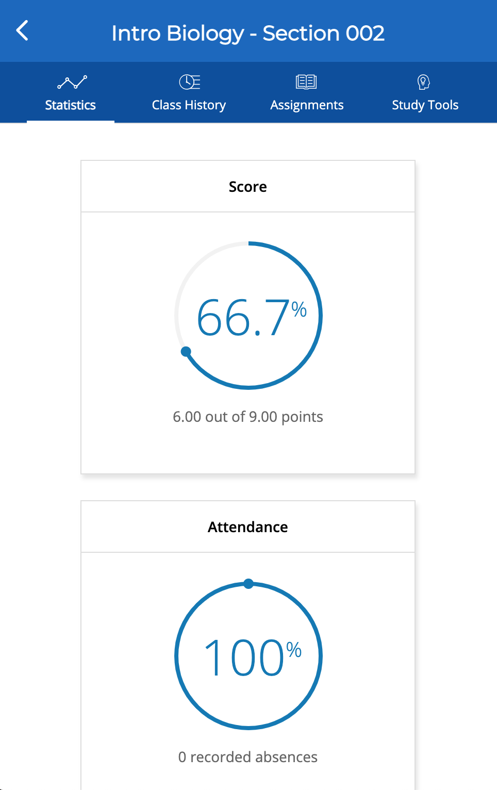
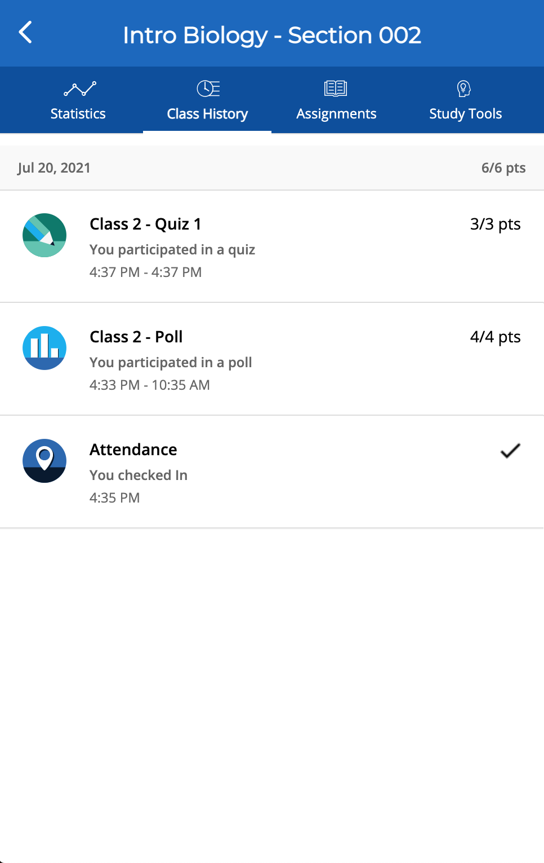
Track your performance and attendance after class
The main screen of iClicker shows your
Statistics. Here you can access your
performance and participation score for
polls and/or quizzes. You will also see an
overview of your Attendance.
Class History provides a detailed view of your individual session results, by date. You can select an individual session to view more details, including results and images of polling questions to use as a study guide.

Slide 15
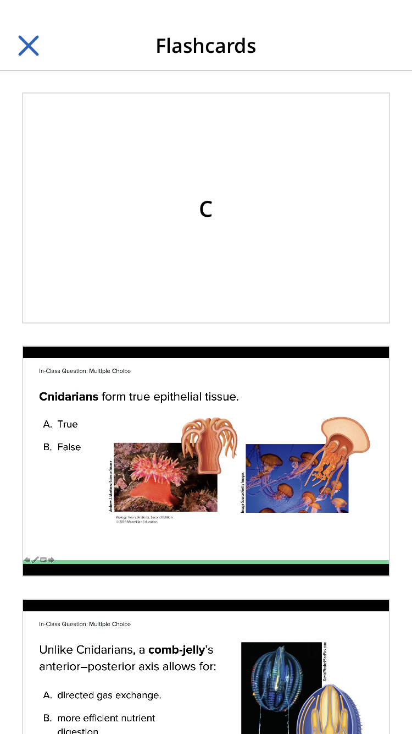
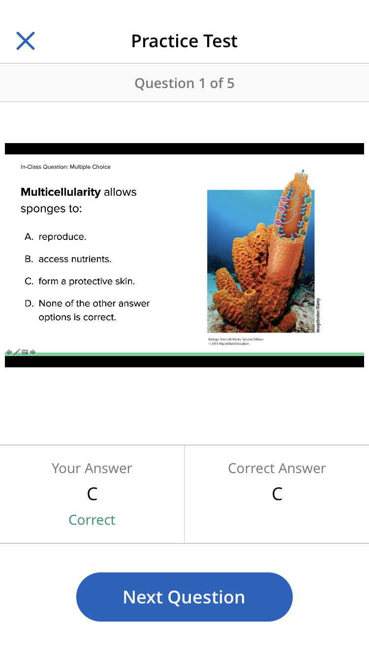
Use iClicker to study
[Delete this slide if you are not grading questions or sharing question images with your students.]
You can flag questions that we covered in class to add them to the Study Tools section of iClicker.
The Study Tools section allows you to review the material we covered in class as Flashcards or Practice Tests.

Slide 16
Questions or Trouble Registering?
Visit iclicker.com/support to submit a support ticket and contact the tech support team.
I have also added these steps and links to helpful troubleshooting guides for iClicker in the syllabus.

